Slide 1
BDA 2025
Johan Westerhuis
Biosystems Data Analysis
Swammerdam Institute for Life Sciences
University of Amsterdam

Slide 2
Biosystems Data Analysis
Linear Algebra + R Matrices
Preprocessing Gene expression data
Explorative Analysis
  PCA
  Clustering / Visualization
Supervised Analysis
  Classification (LDA / PCDA)
  ANOVA/ASCA
  Random Forest
Validation
Microbiome Data Analysis
Omics data
  Transcriptomics
  Metabolomics
  Microbiome

Slide 3
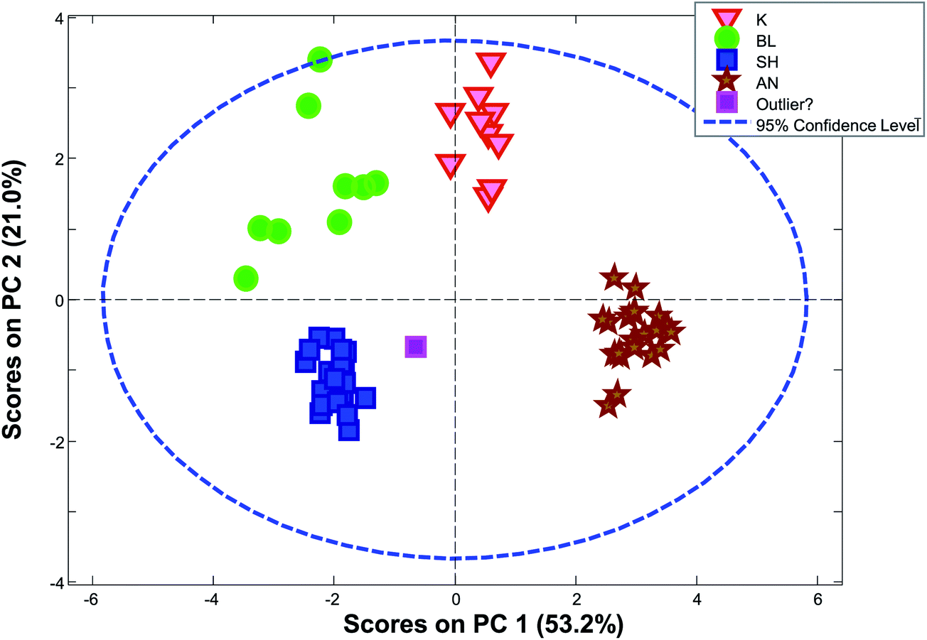
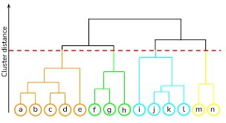
Methods
Exploration (X)
  PCA
  Clustering
  Y information is not used in calculations, but only to color samples
Supervised analysis
  Use Y to calculate model (Y = Xb + E)
  Classification: Y defines groups
  High dimensional ANOVA: Y defines experimental design information
  Regression: Y defines quantitative information
Machine learning for nonlinear models
  Random Forest
  Neural Nets
Validation:
  Test whether model does not overfit / effects are different from zero
Variable (metabolites / genes)
Response (Y)
Data (X)
Samples
Univariate analysis (Gene expression data)
  Comparability
  Error structure
Multivariate data analysis methods
  Gene expression and metabolomics data
Microbiome data
  Sparse and compositional data requires specific multivariate data analysis tools based on between sample distances

Slide 4
CREW
Lecturers:
Anna Heintz-Buschart : a.u.s.heintzbuschart@UvA.nl
Douwe Molenaar: D.Molenaar@VU.nl
Roel van der Ploeg: G.R.Ploeg@UvA.nl
Gustavo Stolf Jeuken: g.stolfjeuken@vu.nl
Aalt-Jan van Dijk: a.d.j.vandijk@uva.nl
Johan Westerhuis: J.A.Westerhuis@UvA.nl
Computer lab TAs:
Italo Rossi del Aguila: i.rossi.del.aguila@student.vu.nl
Pia Mozdzanowski: p.mozdzanowski@student.vu.nl
Kevin Arness: k.arness@student.vu.nl
Alex Sánchez Cano <a.sanchezcano@uva.nl

Slide 5
https://datanose.nl/#course[129552]
Schedule
Groups

Slide 6
BDA-day
Preparation (reading paper) 4h
Lecture (2h)
Computer lab exercises (3h)
The Project (3h)

Slide 7
The Project
Do it yourself part on the same dataset (Caldana paper)
Apply methods, interpret results, R-programming
Work in pairs
Hand in after week 1 (Tuesday January 14th 10:00 (AM))
Hand in after week 2 (Wednesday January 22nd 08:00 (AM))

Slide 8
Computer practical (rooms change each day):
G0.05 (group A)
  Johan Westerhuis, Pia Mozdzanowski
A1.28 (group B)
  Anna Heintz Buschart, Kevin Arness
G4.15 (group C)
  Roel van der Ploeg, Gustavo Stolf Jeuken, Italo Rossi del Aquila

Slide 9
Discord BDA25
Additional source of help when not at campus
Per topic text channel + general channel
Code (see announcement Canvas)
See announcement Canvas
Web lectures BDA25

Slide 10
Others
BDA Glossary
Evaluations
- There will be a slide connecting all methods. This slide will be used for all lectures such that it is clear where the method fits in the course and how it is connected to the other methods.
- We will discuss the aim of the method in more detail and provide some more examples on how the method is used in a general application and how the interpretation should be done.
- We will discuss the learning goals for the topic at the beginning of the lecture and will test whether these goals have been reached at the end of the lecture.
- We will clarify how to prepare for each lecture, and how to use the provided course material.

